Slide 1
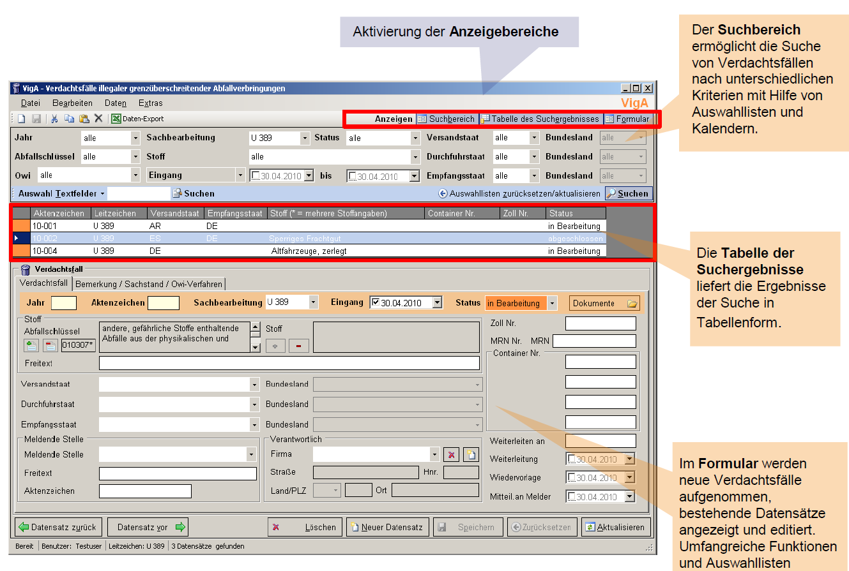
Search section
Suspicion cases of illegal waste shipments
Table of search results
Form to enter suspicion cases

Slide 2
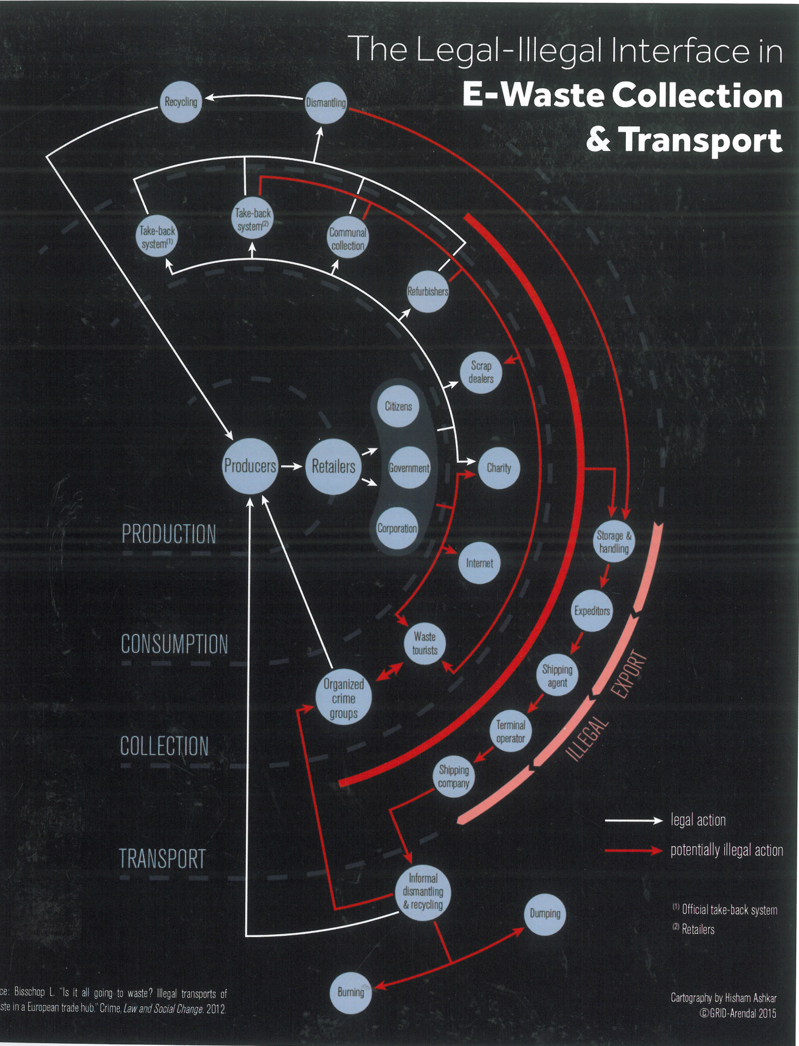

Slide 3
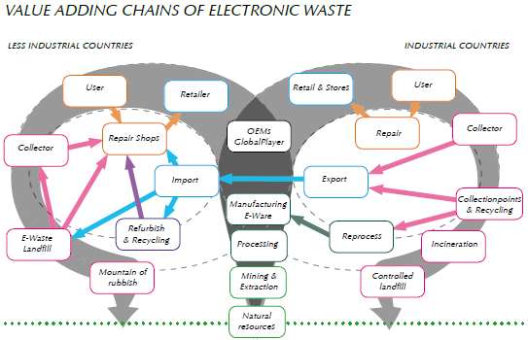

Slide 4
